Slide 1
Brain Injury Report Out Day
DARS Brain Injury Services Coordination Unit

July 24, 2015
The Place at Innsbrook – Glen Allen, Virginia

Slide 2
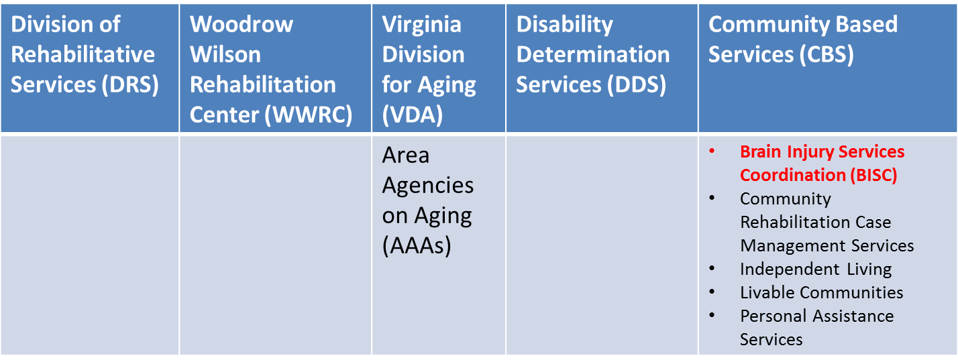
DARS has 5 divisions:

Slide 3
DARS BISC Unit
Virginia Brain Injury Council (VBIC)
Commonwealth Neurotrauma (CNI)
  Initiative Trust Fund
Federal TBI Grant
Brain Injury Direct Services (BIDS) Fund
Personal Assistance Services for People with Brain Injuries (PAS/BI)

Slide 4

Virginia – believe it or not! – has many “firsts” in brain injury: trauma registry, dedicated brain registry, statewide advisory council, designated state funding, clubhouse model, sports concussion, helmet laws
DARS designated as lead state agency for BI in 1989, per Code of VA: “coordinate services for people with physical and sensory disabilities, including traumatic brain injury”
DARS hired BI State Coordinator in 1992
VBIC and the Virginia Alliance of Brain Injury Service Providers (VaBISP) develop annual priorities and legislative initiatives (recent focus on Brain Injury Medicaid Waiver and neurobehavioral treatment services; expansion of services statewide).
BISC works with the Virginia Brain Injury Council (VBIC), an advisory group to the DRS Commissioner and other VA policymakers.

Slide 5
BISC Unit administers $6+ million in programs / services via state and federal funding.
State general funds appropriated by the General Assembly used to contract with 10 organizations providing 13 programs statewide:
  Case Management (adults and children)
  Brain Injury Clubhouse / Day Programs
  Community Support Services (life skills training)
  Statewide Resource Coordination
  Residential Support Services (approx. 25).
Other services:
  Community Impact Activities (public awareness, outreach, education)
  Community Support Services (life skills training)
  Supported Living Services (individual and small residences)
About 3,800 individuals receive direct services annually; 25,000+ nondirect services (education, public awareness, outreach services)

Slide 6
Virginia’s HRSA TBI Grant
Initial award 1998-2000. Total federal funds since 1998: $4,632,200
Current HRSA Grant:
  “Facilitating Access to : FACES”
  May 1, 2014 through May 31, 2018
  Federal: $250,000 / year; State General Funds: $125,000 / year as state cash match; Total: $1,875,000 over 5 years.
Partner Subcontractors:
  Brain Injury Association of Virginia; James Madison University;
  University of Virginia
Major Activities:
  Study on Access to Neurobehavioral Services in Virginia
  BI Screening implementation at 8 pilot sites (AAAs, CILs, CSBs, F&CCs)
  Caregiver Forums; Brain Injury Report Out Day
  Webinars, Listserv / On-Line Case Management Forum
  Education / Written Materials / Outreach, I&R

Slide 7



